Slide 1





SEMLEP Infrastructure Summit
Thursday 27th October 2016

Slide 2
Clive Faine, Managing Director, Abbeygate Developments Ltd and Chair of SEMLEP’s Property Development and Infrastructure Group (PDIIDG)

Slide 3
The Importance of Commercial Management in Infrastructure
Phil Hardy Bishop
RICS Director of UK Infrastructure

Slide 4

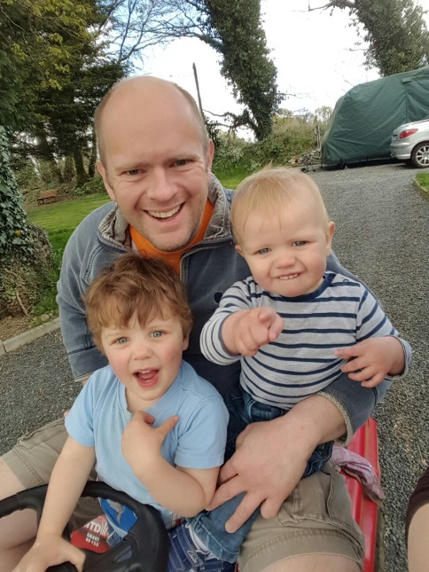





Phil Hardy-Bishop

Slide 5



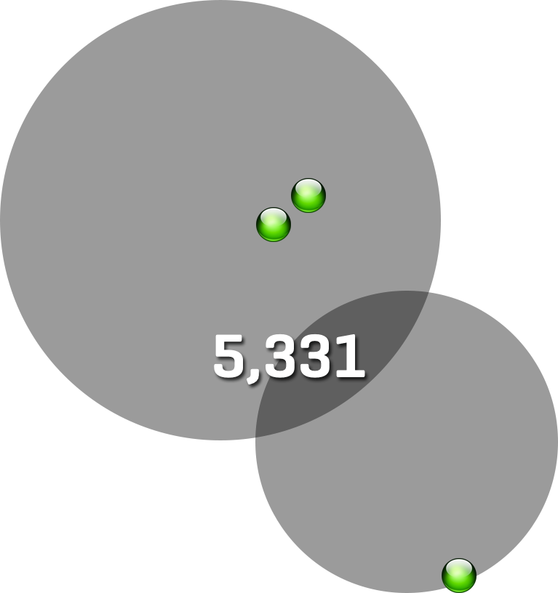
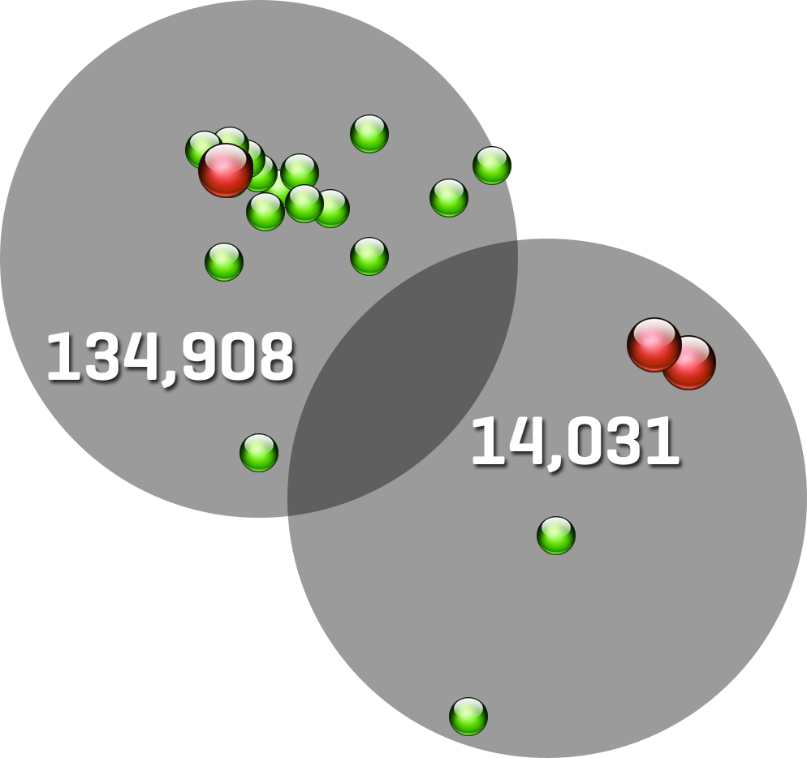
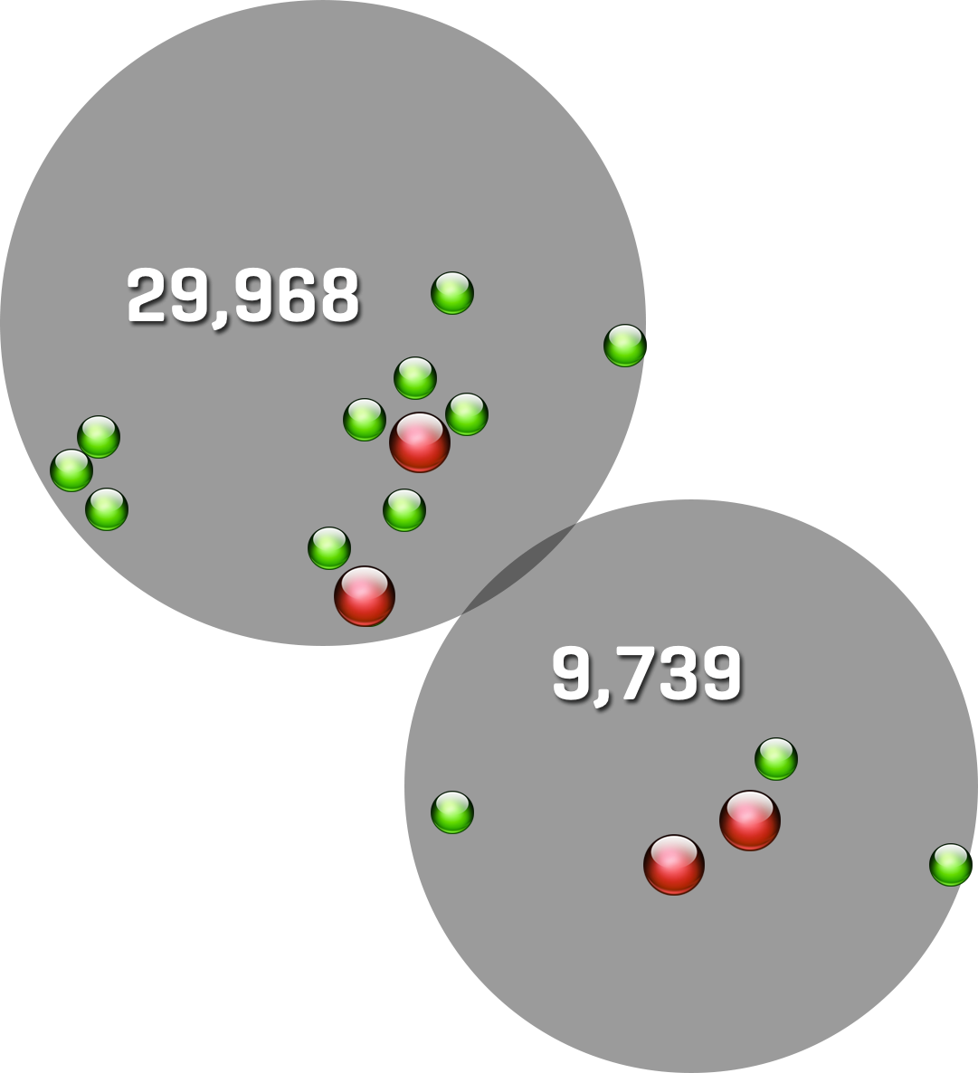




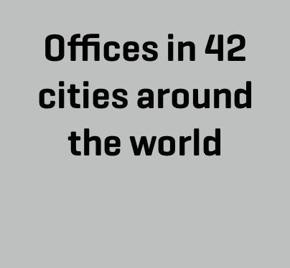


Slide 6

Infrastructure Vision
RICS in infrastructure
RICS is the Hub of Commercial Delivery for Infrastructure and the Built Environment encompassing:
Professional Skills
Standards and Services
Thought Leadership
Why Important?
Integrated Transport systems
Digital Networks
Sustainable Resources

Slide 7
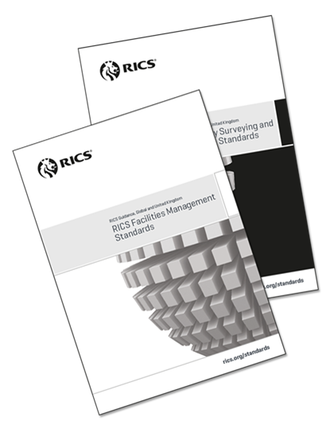
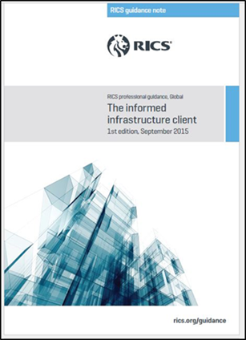
RICS Standards and guidance
The RICS QS and Construction Standards “The Black Book” defines
good technical standards for QS and construction professionals.
Standalone guidance notes – including Management of Risk,
Cost Reporting, Cost Analysis and Benchmarking, Cash Flow Forecasting, Developing a Construction Procurement Strategy.
Infrastructure – new guidance for 2016
Informed Infrastructure Client
Commercial Performance
The Role of the Commercial Manager in Infrastructure
Industry insight papers - sustainable rail supply chains
BIM and Engineering
SME Management in the supply chain
Skills and training
Leadership
Whole life cycle costing
Procurement
Notes:
The QS and Construction Standards includes:
- Methodology to Calculate Embodied Carbon
- Retention
- Damages for Delay to Completion
- Defining Completion on Construction Work
- Acceleration
- Construction Insurance
- Valuing Change
- Conflict Avoidance and Dispute Resolution in Construction
- Electronic Document Management
- Cost Analysis and Benchmarking
- Cash Flow Forecasting
- E-Tendering
- Developing a construction procurement strategy
- Construction security and performance documents
- Termination of Contract, Corporate Recovery and Insolvency
- Capital Allowances and Remediation Relief
- Managing Communications
Special offer - buy the complete QS and Construction suite and receive a FREE presentation box.
"Carillion supports and endorses the use of RICS professional standards in construction and uses the RICS Black Book. It is a great training aid and used extensively in the APC training and development process."

Slide 8

ICMS
International Construction Measurement Standards
Construction measurement standards refer to the way construction project costs are calculated, classified and reported.
Not about the units of measurement ($, £, €, ¥ etc.)
but instead the ‘line items’ in the calculation such as
labour, land purchase, design, materials and client costs.
Knowing what is, and what is not included in the cost of a
construction project is vital to:
Understanding how it compares with other projects within or outside that market
Accurately assessing value-for-money
Assessing and benchmarking the ‘footprint’ of a construction project
Reporting national and international construction statistics
Notes:
ICMS
Construction measurement standards refer to the way construction project costs are calculated, classified and reported.
What is included in the ‘cost’ and what is not.
Not about the units of measurement ($, £, €, ¥ etc.) but instead the ‘line items’ in the calculation such as labour, land purchase, design, materials and client costs.
Aims and objectives
To agree what is included and excluded from construction costs at both a project level and a national reporting level.
To create (a framework for) a standard system of costing for building and civil engineering projects (works) that will allow cost comparisons to be made on a like-for- like basis across countries.
To allow Governments and international bodies compare the costs of construction of building and civil engineering projects (works) so that:
national costs can be benchmarked;
the causes of differences in costs can be identified;
properly informed decisions on the location of construction projects can be made; and
the relative performance of the construction industry in different countries can be determined.
Knowing what is, and what is not included in the cost of a construction project is vital to:
Understanding how it compares with other projects within or outside that market
Accurately assessing value-for-money
Assessing and benchmarking the ‘footprint’ of a construction project
Reporting national and international construction statistics
The standards used today differ within countries and from one jurisdiction to the next.
Depending on where the project is located the costs might include some or all of the following elements:
Labour and materials
Land acquisition
Professional Fees
Client costs
Inability to accurately compare project costs
Investment risk
Lack of transparency
Leading to:
Under-investment in construction projects
Time and cost overruns
ICMS establishes a global standard for assessing project costs.
It defines what should be included in the calculation of a construction project.
It will enable global consistency.
The standard will allow capital cost comparisons to be made across building and civil engineering projects (works). Whole lifecycle costs will also be included if possible, or a firm link developed to allow further work on this subject.
It will:
adopt universal definitions of construction costs and the associated variables;
create a single classification system for building and civil engineering projects (works) for use with digital tools such as BIM;
recommend a consistent data framework for the collation of national statistics;
be as simple as possible, commensurate with allowing robust comparisons to be made;
articulate with local standards and the IPMS wherever possible;
recommend a standard reporting format;
allow global cost comparisons and benchmarking for global investors, corporate bodies and contractors;
provide a checklist for international best practice;
when combined with IPMS, consistent cost comparisons on a per m2 basis;
provide consistent language and terminologies for the worldwide, and increasingly mobile, profession; and
accommodate the need for continuous refinement, updating and change.
Who is developing ICMS?
Developed by a coalition of professional bodies from around the world.
Coalition established during a meeting at the IMF, Washington D.C. in June 2015.
Organisations have committed to develop and implement the standard.
An independent Standards Setting Committee (SSC) has been established to write the international standard.
The SSC is comprised, in total, of 27 experts from around the world.
A public consultation on the ICMS will run before the SSC ratifies and hands over the final standard to the Coalition.
ICMS is being developed in two parts as follows:
ICMS 1: Agree higher level cost centres and definitions for infrastructure (with buildings as a sub-set). Link cost centres and elemental headings with both UN ISIC (using ICMS 1) and IPMS (ICMS 2 in terms of building cost/m2); and
ICMS 2: Define construction cost and harmonise building elemental headings and definitions at a project (management) level . Prepare a relationship map linking ICMS to IPMS.
Who will benefit?
Any party that has a direct or indirect interest in construction projects will benefit.
Those investing in or managing construction projects will benefit significantly.
The public will benefit through enhanced, prudent assessments of public projects

Slide 9
Infrastructure training portfolio
BIM Implementation and management BIM for infrastructure | Collaboration & dispute avoidance Conflict avoidance Early intervention Dispute avoidance
Commercial management & risk Quantity surveying: foundation and advanced Pre and Post contract management Risk management on infrastructure projects Commercial management in infrastructure | Contracts & procurement NEC3 ICC / ICE FIDIC JCT Contract administration
Industry overviews Rail Roads Water | Measurement & standards The informed infrastructure client NRM2 for Infrastructure

Slide 10
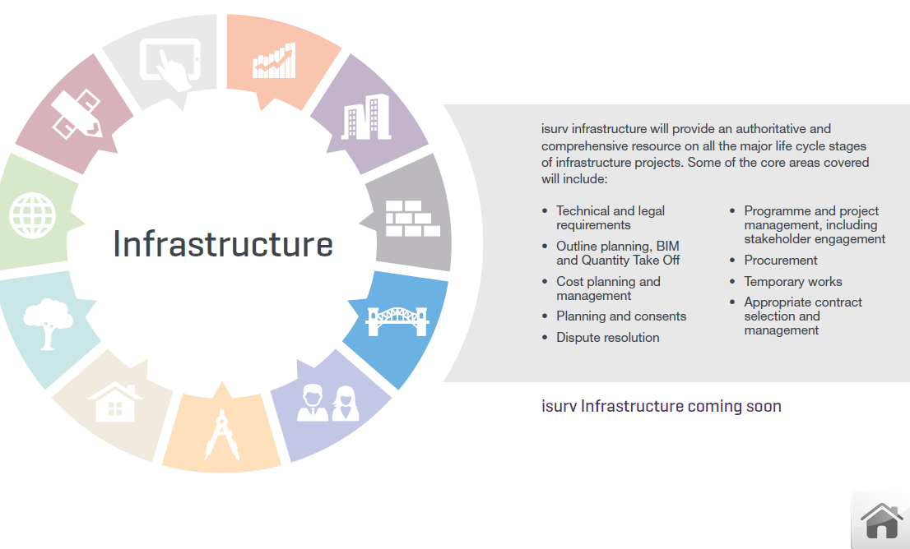
isurv infrastructure
RICS are developing a new isurv infrastructure channel
Estimated publication date: March 2017
Will address a significant need in the industry for practical, authoritative and relevant best-practice intelligence on infrastructure projects

Slide 11
Thought Leadership
Government engagement
Responding and influencing fiscal announcements – Budget, Autumn Statement
Cross government departmental engagement including HMT, Cabinet Office, DfT, DCLG
Secretariat for APPG on Housing
  Party conference events on housing (and infrastructure)
Leading on the skills agenda to inform Department for Exiting the EU
Actively engaged with government Commissions through input of member expertise to contribute to calls for evidence
  National Infrastructure Commission - evidence for 5G, Growth Corridor, National Infrastructure Assessment
  Thames Estuary Growth
Assessing infrastructure landscape and scope for Infrastructure Financing and investor appetite across all sectors

Slide 12
The Importance of Commercial Management in Infrastructure
Phil Hardy Bishop
RICS Director of UK Infrastructure

Slide 13
Funding and delivering infrastructure to support growth
Emma Fraser
Head of Transport Spending, HM Treasury
27/10/16

Slide 14

HM Treasury
HM Treasury is responsible for two key areas:
Ensuring government spending is affordable and value-for-money
Promoting sustainable economic growth across the UK
Enterprise and Growth Unit straddles both the economics and finance functions of the Treasury.

Slide 15
The UK’s infrastructure
Sector | Includes: | Overview
Transport | Rail, roads, ports, airports | Some areas fully private sector (e.g. airports;) others a mixture of public and private (e.g. rail)
Energy | Energy generation (fossil fuels, renewable energy and nuclear); transmission; distribution | Mostly private sector (albeit supported by some government subsidies); regulated by Ofgem
Water | Water treatment, water distribution | Fully private sector; regulated by Ofwat
Waste | Landfill sites, recycling plants | Publicly-financed (central government supports local authorities through private finance schemes)
Telecoms | Mobile networks, fibre-optics etc. | Almost wholly private sector (some public provision in remote areas); regulated by Ofcom
Flood defences | Flood defences | Publicly funded

Slide 16
The state of infrastructure in the UK
UK infrastructure has many strengths:
  The UK has a mature and sophisticated infrastructure base: it has the best electricity and telephony infrastructure in the G7 according to the World Economic Forum’s Global Competitiveness Report.
  It is an attractive place to invest: the Nabarro Infrastructure Index ranks the UK as the most attractive infrastructure investment environment in the world.
However, there remains a broad agreement in academic literature that the UK has historically underinvested in infrastructure.
  UK total investment (measured by GFCF) has been the lowest in the G7 over 2000-15, and was the second-lowest in 2015 just above Italy.
  Performance is weak in terms of both corporate investment (3rd lowest in OECD in 2014) and public investment (7th lowest).

Slide 17
Public infrastructure spending is dominated by transport, but energy receives the most finance overall
86% of public economic infrastructure spending this parliament is on transport, over half of which is on rail.
The level of private sector involvement varies hugely between sectors; once including private finance, energy is the largest sector in terms of planned infrastructure spending.

Slide 18
Changes in infrastructure planning since 2010 include:
Publishing the first ever National Infrastructure Plan (now the National Infrastructure Delivery Plan) bringing together for the first time the Government’s vision and approach for the key economic infrastructure sectors
Creation of the Infrastructure and Projects Authority to provide expertise in the financing, delivery and assurance of major infrastructure projects; to support more effective management and delivery of across government.
Working with a group of leading clients from across the infrastructure sectors to deliver the Infrastructure Cost Review programme, which has reported savings of over £3bn to date
Publishing a National Infrastructure Plan for Skills, which establishes a basis for government to work with industry to ensure the UK has the right skills base to deliver world-class infrastructure
Establishing a new National Infrastructure Commission, which has already started advising the Government on strategic infrastructure needs and ways to meet them

Slide 19
UK economic infrastructure plans
Under the National Infrastructure Delivery Plan (NIDP), public economic infrastructure spending will rise to around 0.9% of GDP by the end of this parliament, while total infrastructure spending will rise to 2.9% of GDP next year.
As a caveat, the NIDP is not an entirely exhaustive list of UK infrastructure projects: the NIDP pipeline only includes projects >£50m and does not identify all private sector infrastructure spending.
Notes:
Might be worth emphasizing that the downward trajectory over time is because the further into the future, the fewer projects are pinned down yet (i.e. it’s not that we’re actually forecasting spending to fall)

Slide 20
The Government is seeking to improve infrastructure delivery in key areas
Issue | Policy solution
Improve the quality and pace of decision-making, with more strategic and joined-up thinking across sectors. | The establishment of the National Infrastructure Commission will allow for a more strategic, long-term approach to infrastructure.
Drive down the costs of implementation: the UK has high implementation costs in all areas of economic infrastructure, including rail, roads, onshore wind and tunnelling, ranging from a 10% to over 100% difference with other countries | Merging IUK with the Major Projects Authority (MPA) to form the Infrastructure and Projects Authority (IPA), so that the Government can cost-effectively manage and deliver major economic projects under one roof for the first time.
Improve levels of investment: as noted, the UK has had the lowest level of total investment¹ in the G7 since 2000, with weak investment in both the public and private sector. | The Government will invest more than £100bn in infrastructure by the end of the Parliament. Investment in transport infrastructure is increasing by 50% to £61bn over this period, with major increases in both rail and road spending.
1 This covers more than just economic infrastructure,. Internationally-comparable data on just economic infrastructure is not widely available

Slide 21
Principles for Infrastructure investment going forward?
‘ ‘I’m also a great believer in what I’ll call for shorthand purposes the Eddington Principle, that often it is modest, rapidly deliverable investments that can have the most immediate impact, particularly on the road network, but also in some places on the rail network’
‘Making sure that it is long-term economic, not short term politics that drives Britain’s vital infrastructure investment’
Notes:
http://blogs.spectator.co.uk/2016/10/full-text-philip-hammonds-conference-speech/
https://www.newcivilengineer.com/latest/chancellor-signals-infrastructure-policy/10010653.article

Slide 22
Principles for Infrastructure investment going forward
The Eddington Transport Study, published in 2006, made a number of recommendations around sound transport investment:
It highlighted that maximizing use of existing networks is just as important as the underlying investment in new infrastructure.
Targeted investment for mature economies such as the UK, with well-established networks and where connectivity between economic centres is already in place, is essential
  …such countries should be focused on the performance of the existing network, particularly where capacity is stretched, as demonstrated, for instance, through congestion or unreliability’
In this light, it is important to understand where infrastructure investment genuinely supports economic growth: there are times when countries have enjoyed economic success without significant improvements to transport; and history highlights that transport does not always deliver expected economic benefits
Notes:
http://webarchive.nationalarchives.gov.uk/20090104005813/http:/www.dft.gov.uk/162259/187604/206711/volume1.pdf (p.3)

Slide 23
Boosting the UK’s productivity
Boosting economic growth and productivity is a key issue for the government in the UK workers produce significantly less per hour than G7 average.
The vast majority of academic literature suggests spending on public capital, and particularly economic infrastructure, has a positive impact on growth.
This is true in the context of roads for instance - studies suggest roads congestion will cost the UK £21 billion a year by 2030. Releasing this congestion and ensuring the road network can cope is essential for providing the necessary connectivity to facilitate better productivity (goods can travel more easily, people can get to work faster)
This applies across other areas of infrastructure, especially digital
Notes:
http://blogs.spectator.co.uk/2016/10/full-text-philip-hammonds-conference-speech/

Slide 24
Devolution
The Chancellor has made clear that the devolution agenda will continue to be taken forward:
‘We have passed a tipping point in devolution in this country. A decisive and irreversible shift in economic and political power……and Britain’s economy will be the better, and the bigger, for it.’
HM Treasury is continuing to support political ambitions to devolve decision-making over infrastructure to regions
This has included setting up Transport for the North to give the North a single strategic voice on its transport priorities, as well as delivering devolution deals for other areas that seek to boost regional infrastructure spending and provide greater local autonomy.
Notes:
http://blogs.spectator.co.uk/2016/10/full-text-philip-hammonds-conference-speech/

Slide 25
Future proofing infrastructure investment
Technology, especially in transport, is rapidly evolving; it is important that investment is aligned with these developments.
In recent years, we have witnessed the impact of market disruptors harnessing the power of mobile technology, such as Uber in the field of transport.
We expect further technological developments to disrupt and change the way infrastructure is provided in the future- for example through low emissions vehicles and controlled autonomous vehicles
It is important to invest to ensure infrastructure facilitates rather than impedes the advancement of these new technologies, and that our networks can cope with the pace of change.
It is also important that infrastructure investment is flexible enough to cater for technologies we don’t yet know about.
Notes:
http://blogs.spectator.co.uk/2016/10/full-text-philip-hammonds-conference-speech/

Slide 26
Leaving the EU
Clearly the vote to leave the European Union on 23rd June will potentially impact the way we invest in infrastructure going forward.
The government is working to understand the likely effects on the financing of infrastructure, and on factors such as the supply chain and workforce skills.
This period is also an opportunity to ensure that infrastructure investment and delivery is made better, and that the UK is equipped to ensure it meets the economic challenges posed by this new situation.
Notes:
http://blogs.spectator.co.uk/2016/10/full-text-philip-hammonds-conference-speech/

Slide 27
In summary
Infrastructure has a key role to play in promoting economic growth and improving the UK’s productivity going forward- securing future investment is critical in this light.
The government is seeking to improve the processes for the decision-making, planning and delivery of infrastructure, through bodies such as the National Infrastructure Commission
It is important that government targets investment as effectively as possible, ensuring that transport schemes maximize the potential economic benefits against the inputs.
Invest in infrastructure is important for facilitating the advance of new technologies now and in the future.
Devolution is still very much on the agenda- this will likely continue to play a larger role in delivering on the UK’s infrastructure investment

Slide 28

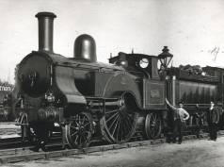


Infrastructure Summit
Thursday 27th October 2016
Empress Suite, Towcester Racecourse
Patrick O’Sullivan – EWR Consortium Rail Consultant

Slide 29
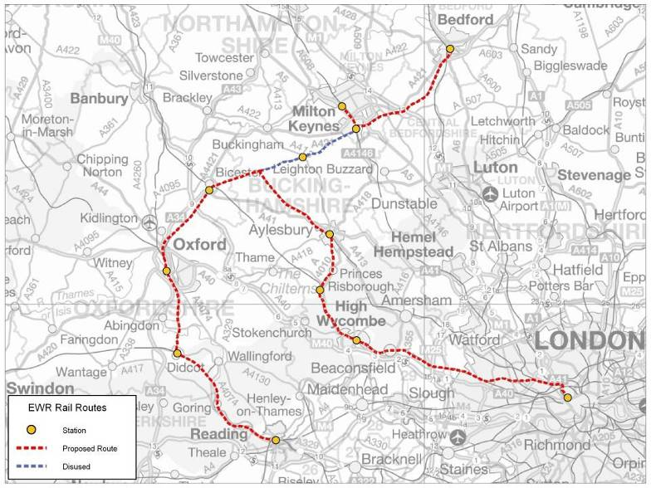
Bedford
Milton
Keynes
Winslow
Bletchley
Bicester Town
Aylesbury Vale Parkway
Aylesbury
Oxford
Princes Risborough
High Wycombe
Didcot
London
Marylebone
Reading
East West Rail (Western Section)
Notes:
29

Slide 30
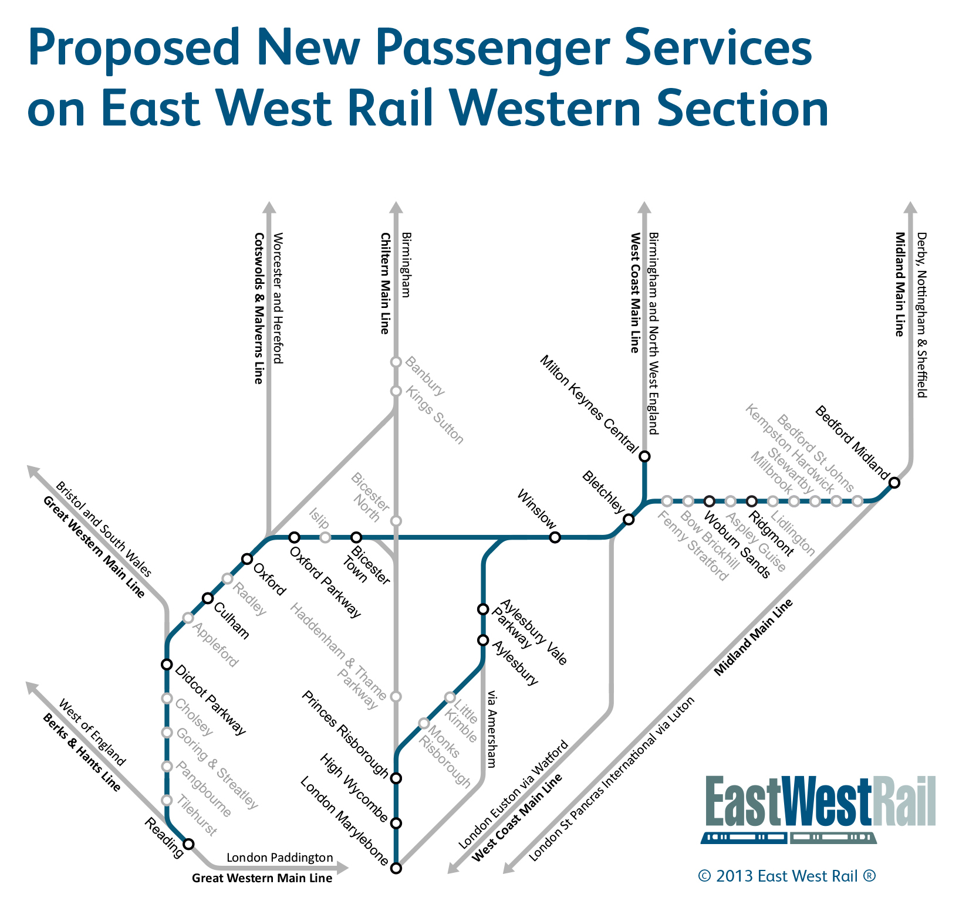
Proposed New Passenger Services and National Mainline Connections (Western Section)

Slide 31
East West Rail
Project Benefits
Delivery Programme
Project Challenges
East of Bedford and Beyond!

Slide 32
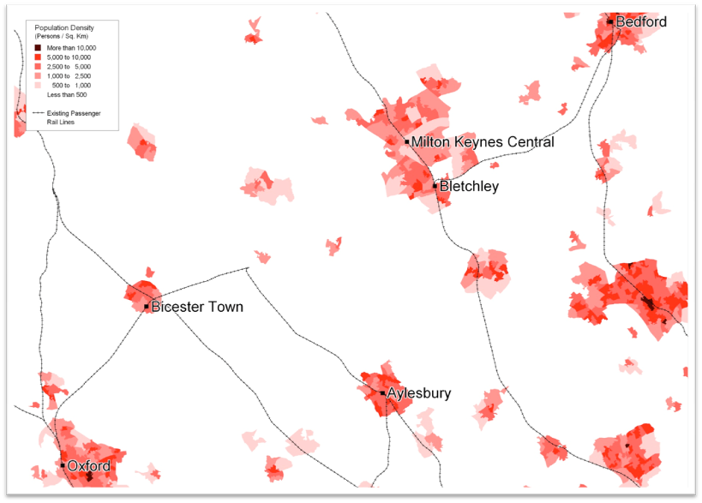
Current population density

Slide 33
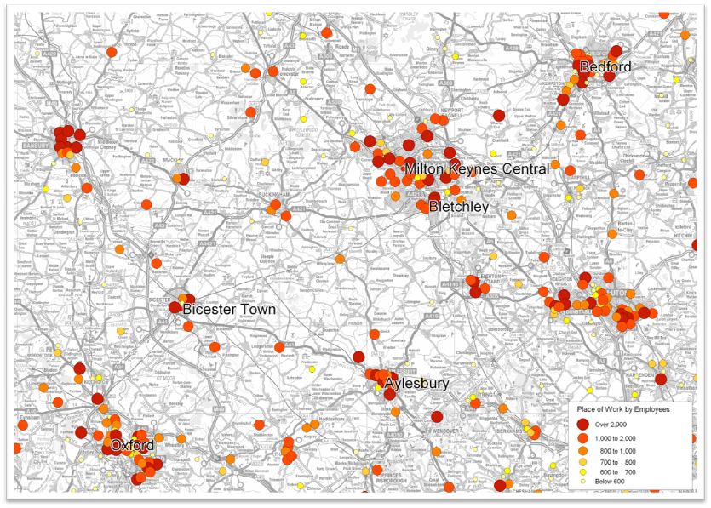
Distribution of largest employers

Slide 34
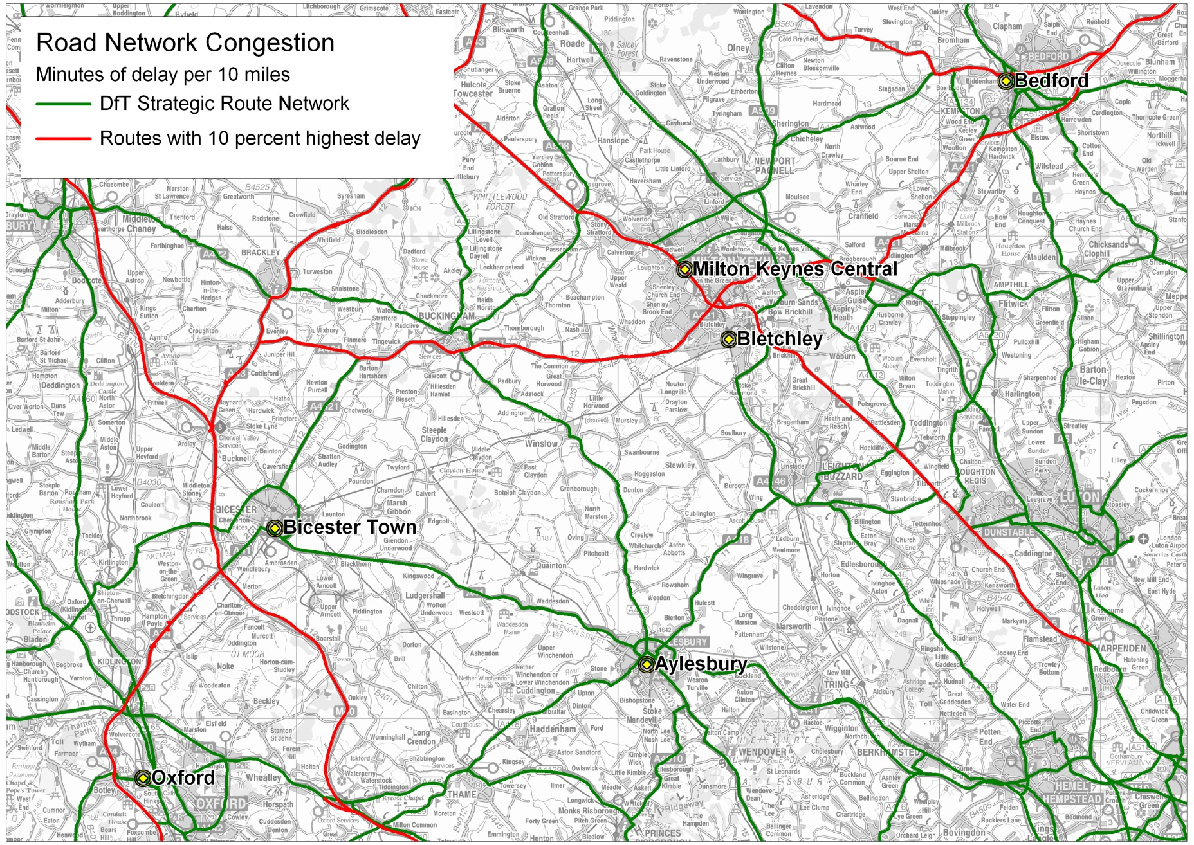
^{Highway network stress today}

Slide 35
^{Population and growth}

Slide 36

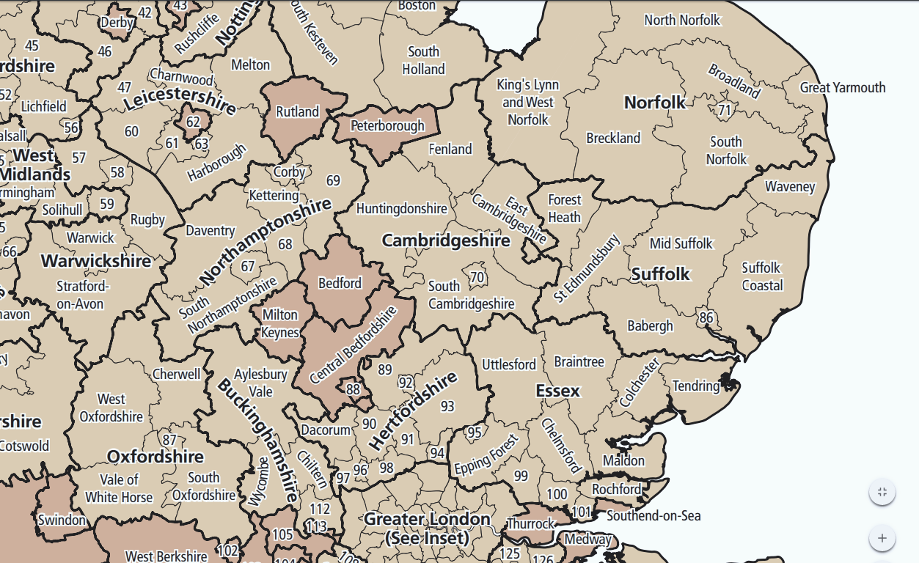
Anticipated Housing & Employment Growth to 2031*
* Unless stated otherwise; provisional figures at April 2016
Eastern Section
Central Section
Western Section
Cambridge City
14,000 dwellings 2011-2031
22,100 jobs
East Cambridgeshire
11,500 dwellings 2011-2031
9,200+ jobs
179ha employment land
Greater Norwich (including Broadland and South Norfolk)
37,000 dwellings including 2,200 dwellings in Wymondham area
27,000 jobs
South Cambridgeshire
19,500 dwellings 2011-2031
43ha employment land
Breckland, Norfolk
19,100 dwellings 2001-2026
Including 4,000 in Attleborough and 6,500 in Thetford
Waveney, Suffolk
7,702 new dwellings 2011-2036
Bedford Borough
17,300 dwellings
15,500 jobs
Forest Heath, Suffolk
6,800 dwellings 2011-2031. 25.3ha additional employment land by 2031
Milton Keynes
28,000 dwellings
42,000 jobs
by 2026
Mid Suffolk
7,500 dwellings 2001- 2021 then 415 per year
11,100 jobs
Suffolk Coastal
7,900 new dwellings 2010-2027
Cherwell District
(Bicester)
9,700 dwellings
18,500 jobs
Ipswich, Suffolk
4,786 dwellings by 2022
18,000 jobs 2001-2025
Babergh District, Suffolk
4,500 dwellings
9,700 jobs
Aylesbury Vale District
31,000 dwellings
17,600 jobs
Wycombe District
2,500 dwellings
400 jobs
Central Bedfordshire
31,000 dwellings
27,000 jobs
St EdmunsdburySuffolk
11,480 dwellings 2012-2031
13,000+ jobs by 2026

Slide 37
Benefits for businesses and individuals …
^{More journey options by rail}
^{Reduced journey times}
Improved local and national rail connections
Avoidance of congested London interchange
Offers strategic opportunities for rail freight
Job creation and easier access to employers
Expanded catchment area for business and access to wider employee base
^{More mobile workforce}
^{Journeys}
^{Jobs}

Slide 38
^{Benefits for the region …}
^{Supports growth plans}
^{Improved} infrastructure makes region more attractive for business and inward investment
Supports increased demand for rail travel
Supports regional growth plans – housing and economic development
Sustainable transport alternative to car
^{Relieves road congestion}
^{Reduction in carbon emissions}
Regeneration of existing railway
^{Environmental benefits}

Slide 39
^{Primary Benefits}
Tax Revenue Forecast to increase tax ^{revenues by}
^{£65 million p.a.}
GDP Forecast to generate uplift in ^{regional}
^{of £132 million p.a.}
Employment Creation of up to 120,000 ^{new jobs}
Carbon Footprint Cars removed (2021) ^{1.47 million}
Additional Rail Demand (2021) 2.58 million trips
Benefit: Cost Ratio (BCR) (Assumes 100% public sector funded) 6.30
Third Party Funding at 15% (Private Sector Developer Contributions) 11.12

Slide 40
Programme Options
The scheme is only funded to GRIP 4 and completion
of the TWAO process
In December 2016 three costed programme options
will be provided:
(a) The quickest programme for delivery;
(b) The most efficient programme for delivery;
(c) The programme for delivery based on current
funding availability.
Options (a) and (b) require additional funding in CP5.

Slide 41
Programme Update
GRIP 3 December 2016
GRIP 3+ July 2017
(HS2 interface)
GRIP 4 July 2017 or December 2019*
Train Services operational date not available
* Pending outcome of Programme Options

Slide 42

East West Rail
Challenges to Delivery
HS2
Planning Legislation
Environmental Issues
Time

Slide 43
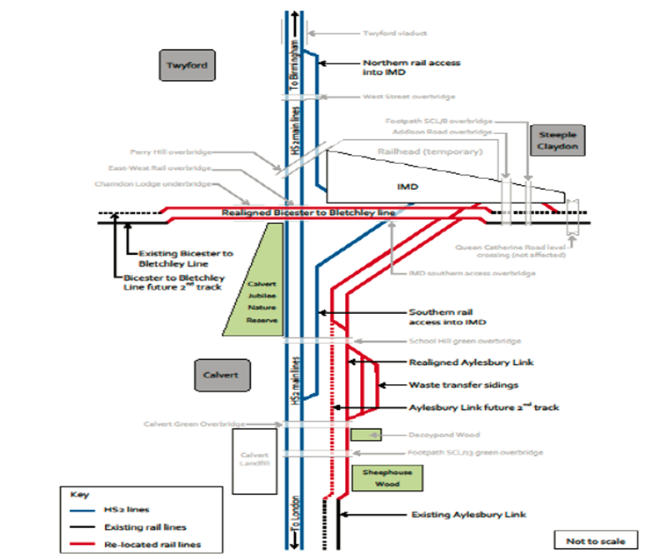
Interface with HS2
Calvert Area

Slide 44

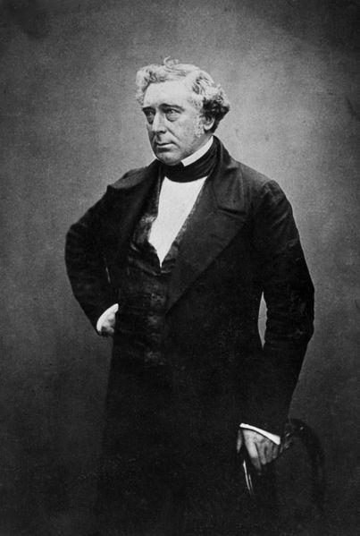
1846 Oxford to Bletchley Junction Railway Act

Slide 45
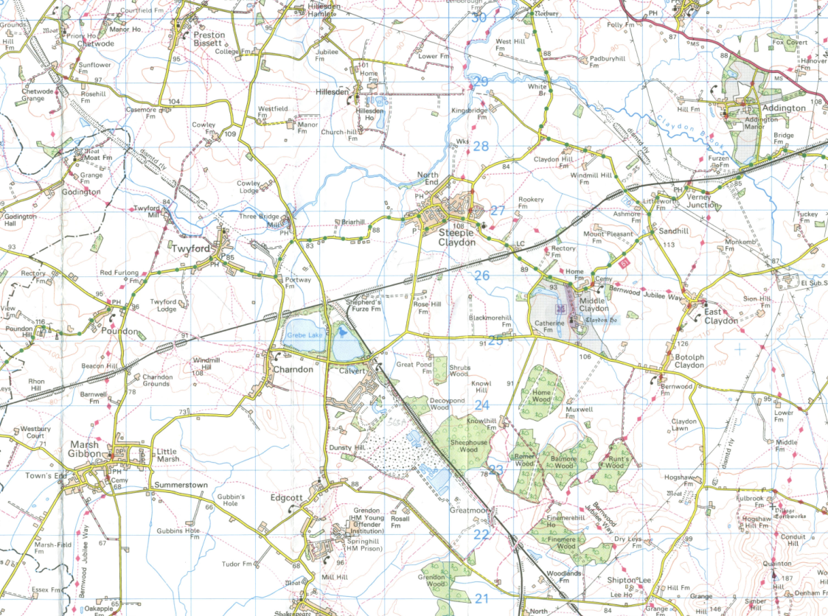
Track laid outside Limits of Deviation
shown in Oxford to Bletchley Junction Railway Act 1846
Deviations from authorised route
Route authorised in original legislation
Section of track for which no authorisation found

Slide 46
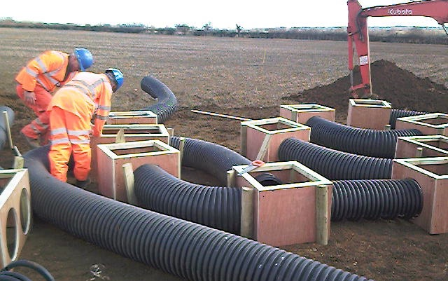
Artificial badger sett construction

Slide 47


Slide 48
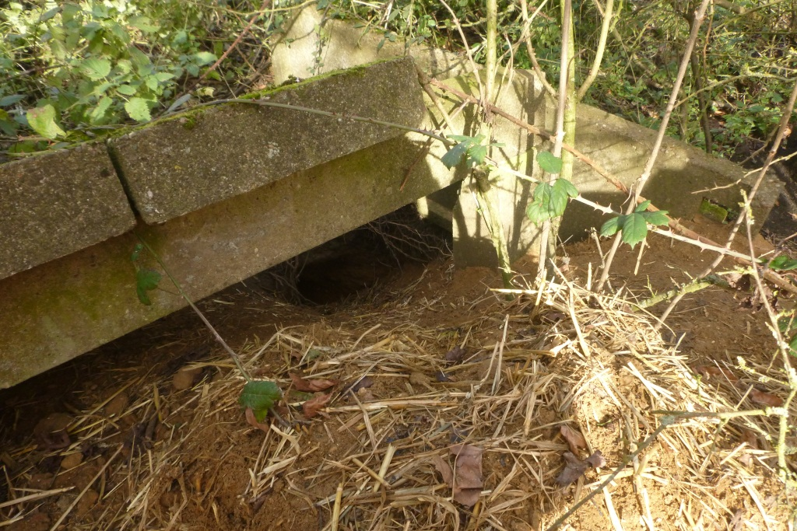
What’s been found so far?
Mothballed section: a very diverse and valuable habitat locally Including the following protected species:
        Badger, newts, bats, all reptile species, many scarce invertebrates and a tremendous variety of plant species
  Confirmed 5 bat roosts in bridges and buildings
  Confirmed dormouse absence
  Few alien invasive species of plant (only cotoneaster)
  Diverse birdlife including 3 red-list and 6 amber-list species identified to date

Slide 49
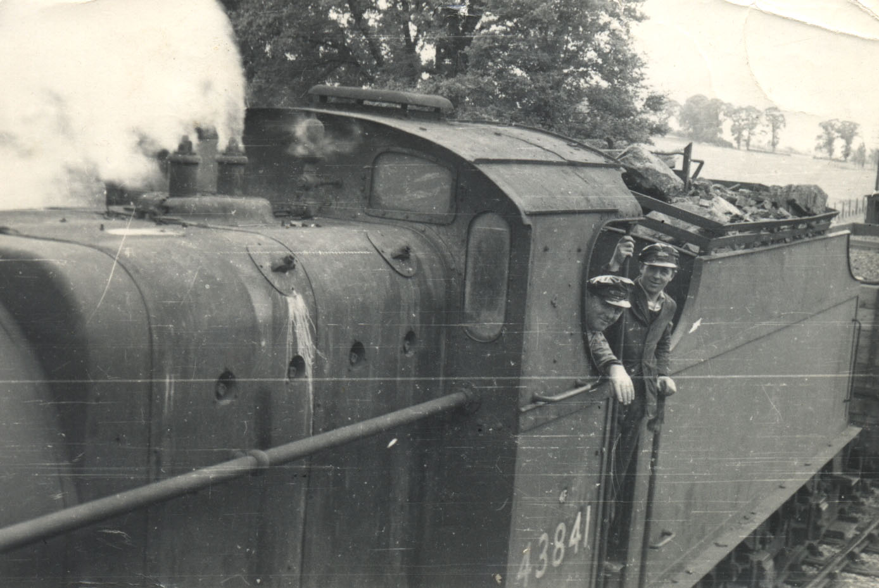

1842 Bletchley to Bedford opened
1851 Oxford to Bletchley opened
1862 Bedford to Cambridge opened
1967 Line closed to passengers
1993 Line closed to freight
1995 EWR Consortium established
1995 Early Development Work
2001 GRIP 1 Pre-feasibility
2006 GRIP 2 & 3 Optioneering
2009 GRIP 4 Single option selection
2010 Development of Business Case
2011 Autumn Statement – Central Government Support
2012 APPG formed by Iain Stewart MP
2012 EWR included in HLOS
2016 GRIP 3 by Network Rail
2018 GRIP 4
20XX GRIP 5 - 8
Timeline of the Project

Slide 50
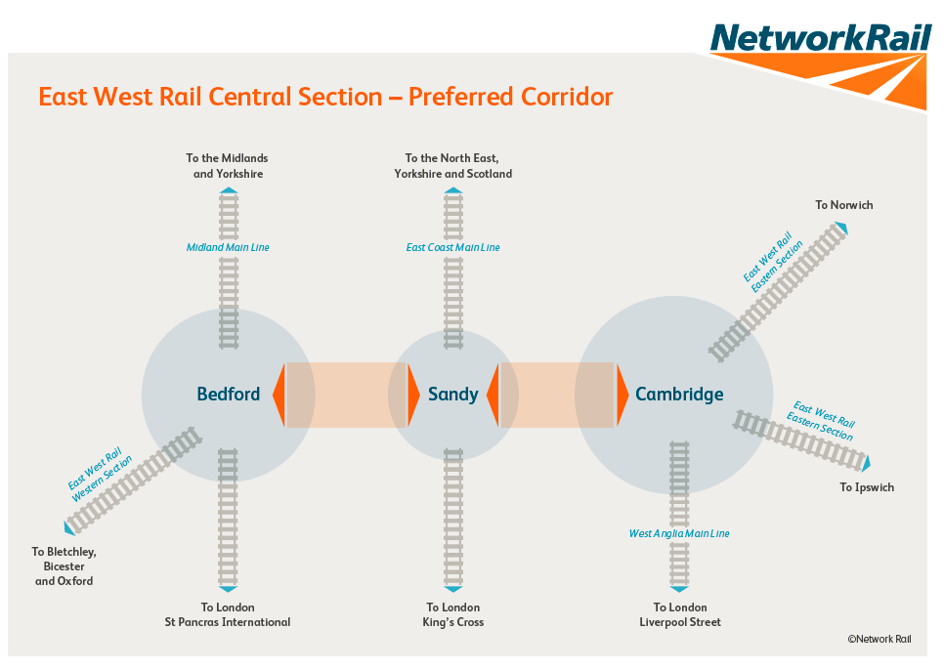

Slide 51
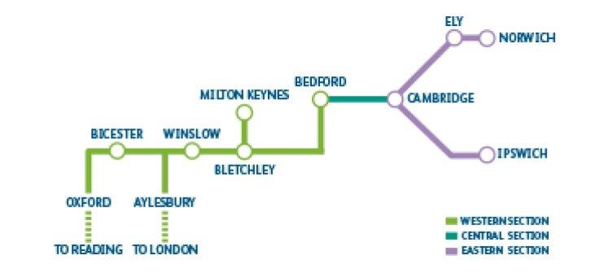

Slide 52
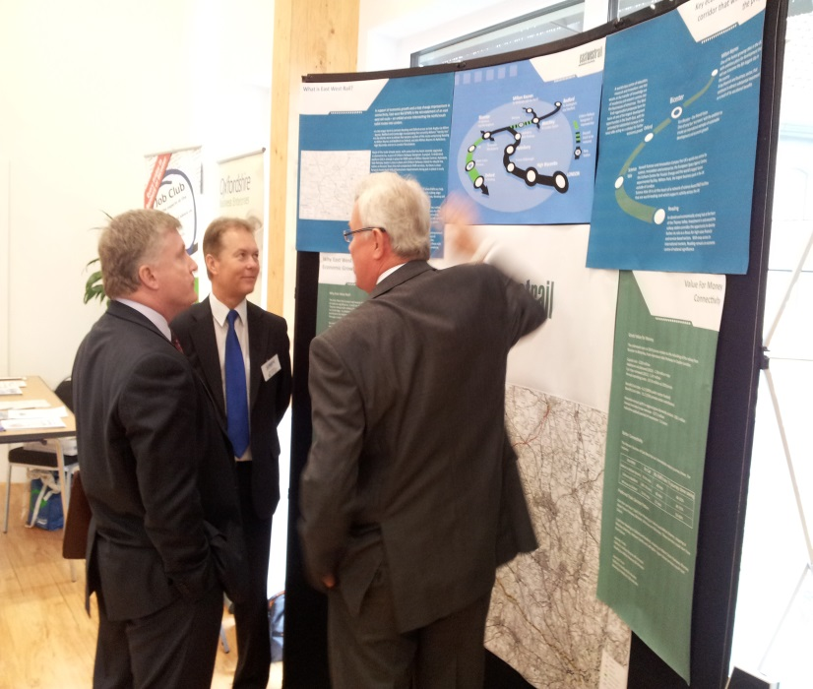
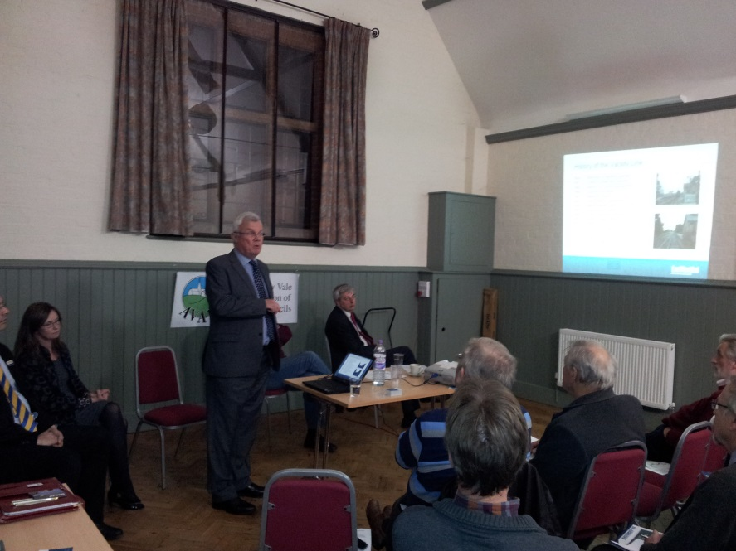
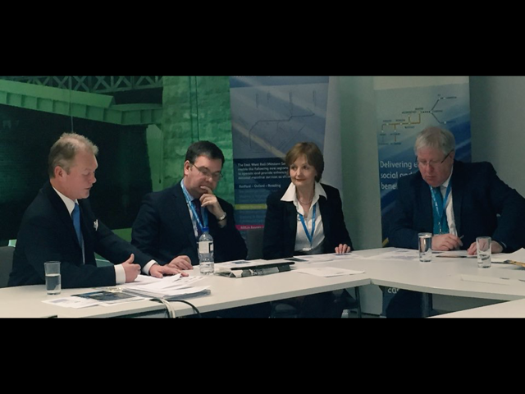
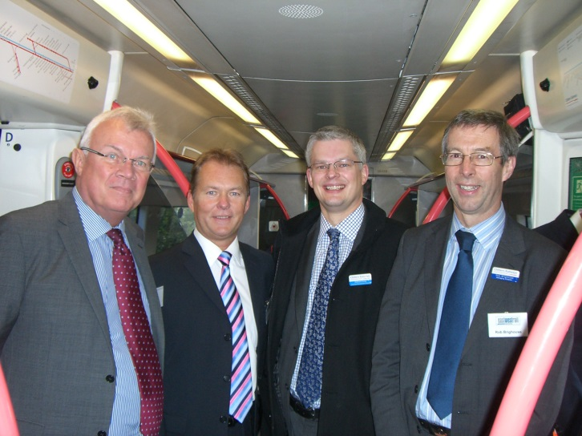
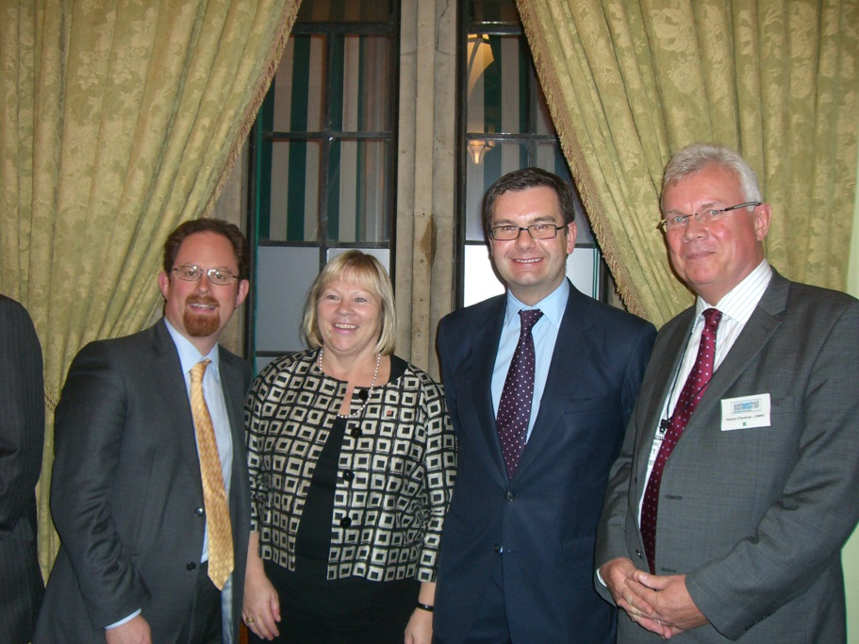
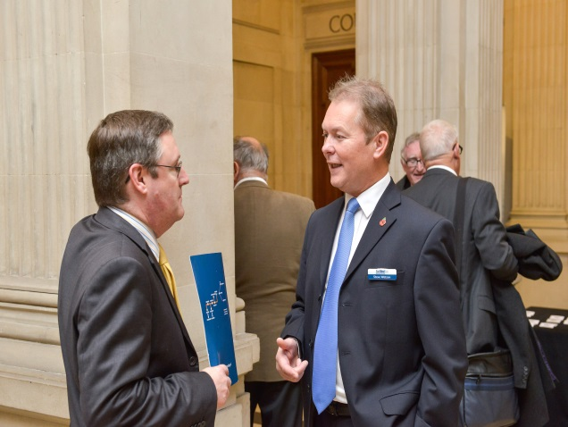
Any Questions?

Slide 53
Highways England
SEMLEP Infrastructure Conference
Simon Amor
Asset Development Manager

Slide 54
Highways England
Highways England was launched in April 2015. We are the new public company responsible for operating, maintaining and modernising the strategic road network – that’s 4,300 miles of motorways and major A roads.

Slide 55
Highways England Objectives
Strategic Outcomes:
Supporting Economic Growth
A Safe and Serviceable Network
A More Free Flowing Network
Improved Environment
An Accessible and Integrated Network

Slide 56
Supporting Economic Growth
Deliver 112 individual schemes to modernise the network
£15.2 billion investment
Generating £4 in economic benefit for every £1 invested
Growth and Housing Fund

Slide 57
A Safe and Serviceable Network
Safety is our first imperative
No one should be harmed when travelling or working on our network
Reduce the number killed and seriously injured by 40% by end of 2020
90% of Strategic Road Network with safety rating of EuroRAP 3*
Work with partners on driver awareness and safer vehicles

Slide 58
A More Free Flowing Network
Planning and managing roadworks
Clear 85% of incidents within 1 hour
Additional capacity through the RIS and smart motorways
Improve traffic information
Improve services we offer our customers

Slide 59
Improved Environment
Mitigate at least 1,150 Noise Important Areas
Publish Biodiversity Action Plan
Invest £300m to deliver specific environmental enhancements
Focus on water, flooding, carbon, landscape and cultural heritage

Slide 60
An Accessible and Integrated Network
Upgrade and increase safe crossings
Integrate with local roads, rail links, ports and airports
Work with key stakeholders and partners
£100m for cycling and accessibility schemes

Slide 61
Delivery of the Road Investment Strategy (RIS)

Slide 62
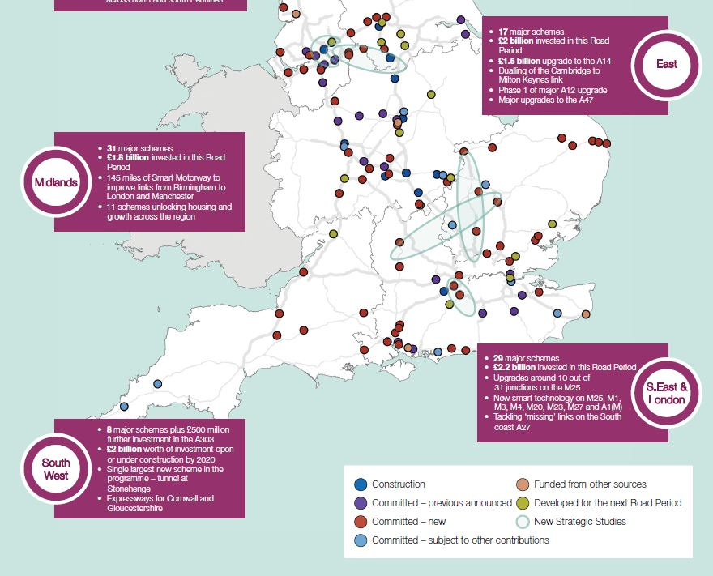

Slide 63
Strategic Studies

Slide 64
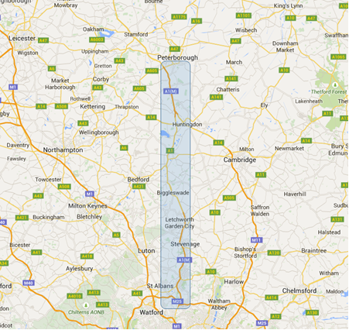
A1 East of England Strategic Study

Slide 65
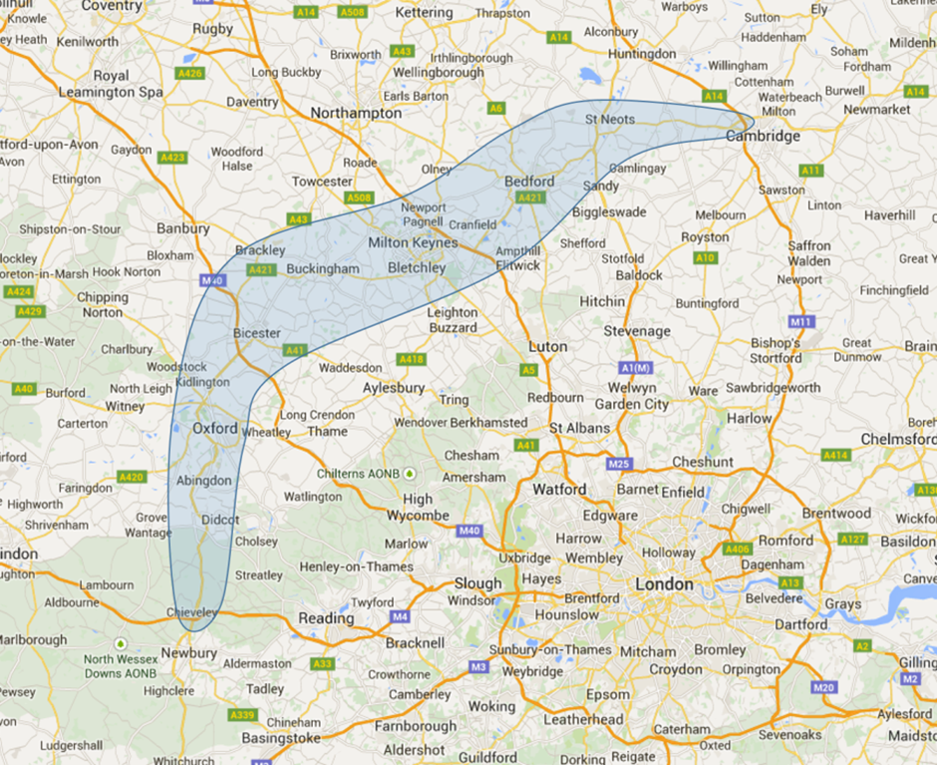
Oxford to Cambridge Expressway Strategic Study

Slide 66
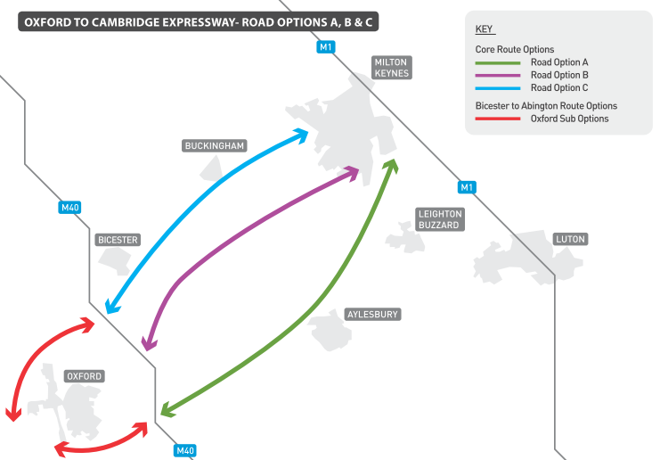
Oxford to Cambridge: Emerging road options shortlist

Slide 67
Strategic Economic Growth Plan

Slide 68

The journey so far
Programme of research:
  The relationship between the SRN and the economy
  International gateways
  Sectoral & property market trends
  Calculating the economic value of the SRN
  Lessons from previous SRN schemes
Intensive programme of stakeholder engagement
  Including LEPs, local government, businesses, developers, road users, sub-national transport bodies, national transport providers, government.
Work to interpret and analyse the evidence, and start to develop a strategy
Nearly ready to play this back to stakeholders…

Slide 69
A discussion paper – coming soon
Anticipated publication December 2016.
Will set out:
  Headlines of the research we have carried out
  Our vision for the SRN contribution to the economy
  How we see our role in the economy
  Our emerging approach to delivering this role
  Our proposed approach to comparing and prioritising the several hundred economic locations highlighted by LEPs and our research.
6-8 discussion points.
Targeted at identified stakeholders – invited by email.
Your views essential to help us finalise the plan for publication in 2017.

Slide 70
Road Investment Strategy 2 and Route Strategies

Slide 71
The Future – RIS2
Completion of schemes identified in RIS1
Revisit and refresh Route Strategies
Outcomes from the Strategic Studies
Work with stakeholders to determine regional priorities.

Slide 72
The process of developing RIS2
Why
The Road Investment Strategy process enables a more strategic process of setting investment.
Previously, ministers have had to choose from a set of historically-determined options.
Now, it is possible to set the agenda and build up an investment programme from the beginning.
What
There are four parts to the RIS:
Strategic Vision
Investment Plan
Performance Specification
Statement of Funds Available
When and how
Process published with Budget 2016:
Research phase gathers evidence for potential priorities and investments; seeks the views of stakeholders. This is scheduled to last until the end of 2017.
Formal negotiations with Treasury and Highways England would start in 2018. This would determine the funding available and set the performance specification.
The RIS will be formally published by March 2020, with construction starting from 2020
Where are we now
Strategic Studies are well advanced
Evidence collected for Route Strategies through online mapping tool
Process for gathering stakeholder views to inform the RIS underway

Slide 73
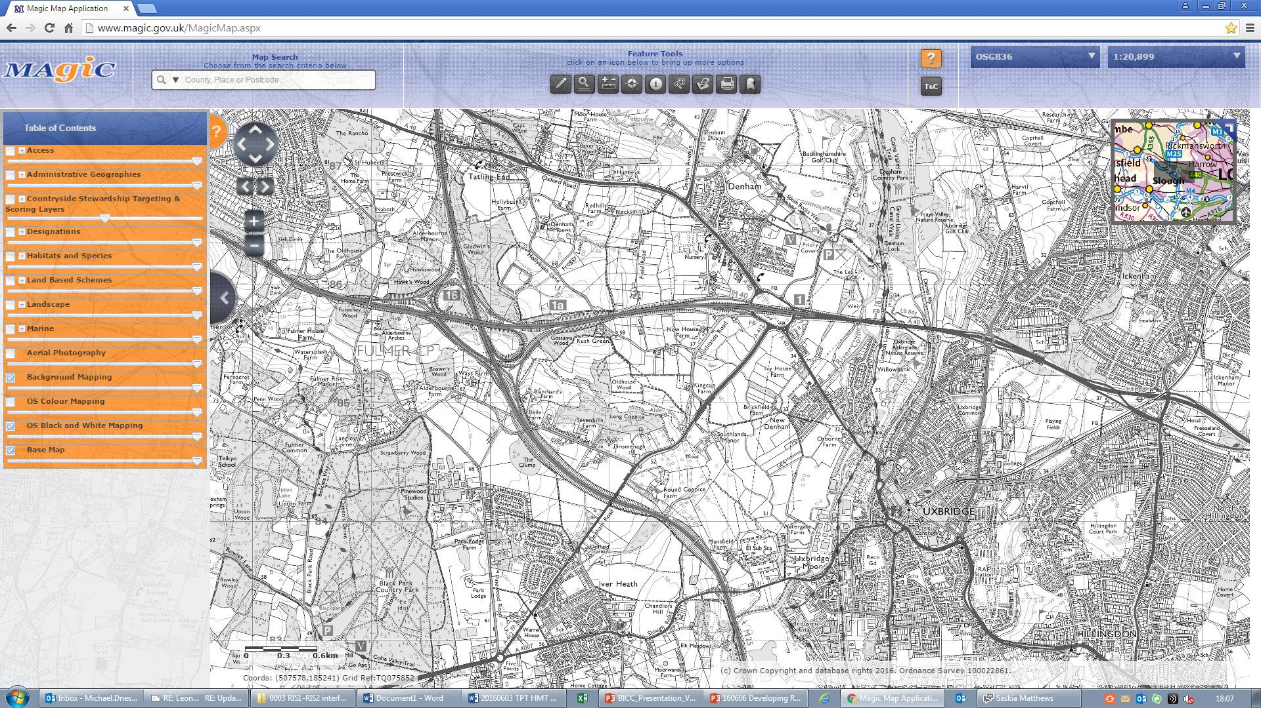
How do we currently think RIS2 will look?
1
2
3
RIS2 has five key aims …
It seeks to take account of a changing world …
And will need to make decisions about …
Economy
Network Capability
Integration
Environment
Safety
Devolution
Growth & Economic Change
Population Growth & Demographic Shifts
Environment & Climate Change
Technology
Shape of the Network
Lessons from RIS1
Linking up our work with the National Infrastructure Commission
National Roads Fund
73

Slide 74
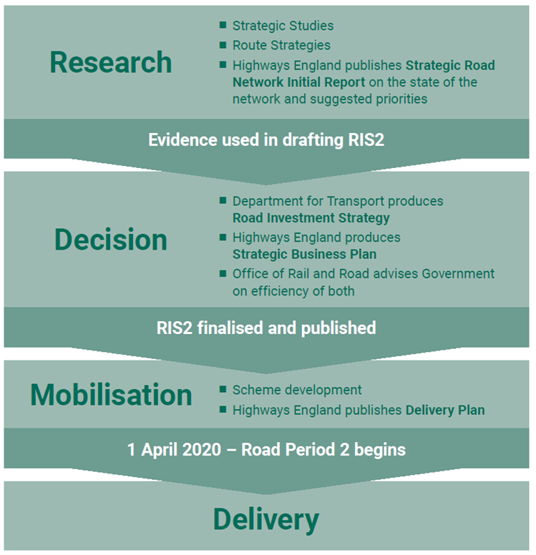
Road Investment Strategy: key dates
until the end of 2017
between 2018 and 2020
This is also when
the National Roads Fund comes on stream
74

Slide 75
The launch of Highways England is an opportunity to strengthen relationships with existing stakeholders and to work with new ones.

Slide 76

Bedford & Milton Keynes Waterway Park
James Clifton & Jane Hamilton
27 October 2016

Slide 77
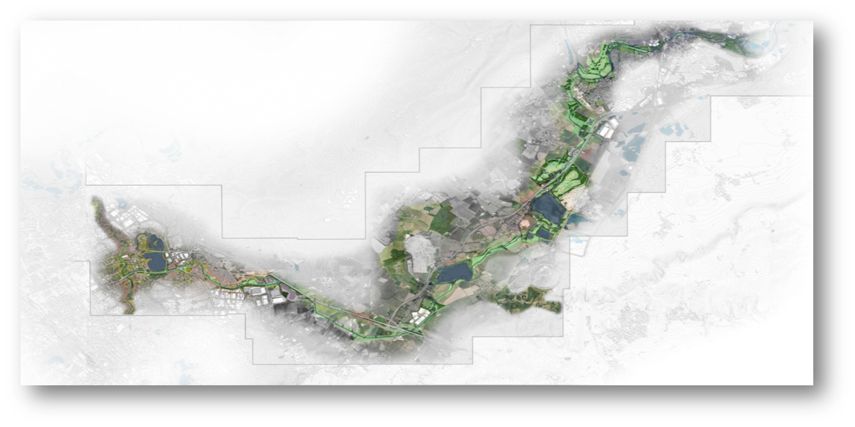
Our Vision
  To create a nationally recognised Waterway Park linking Bedford and Milton Keynes for the social, economic & environmental benefit of our communities

Slide 78
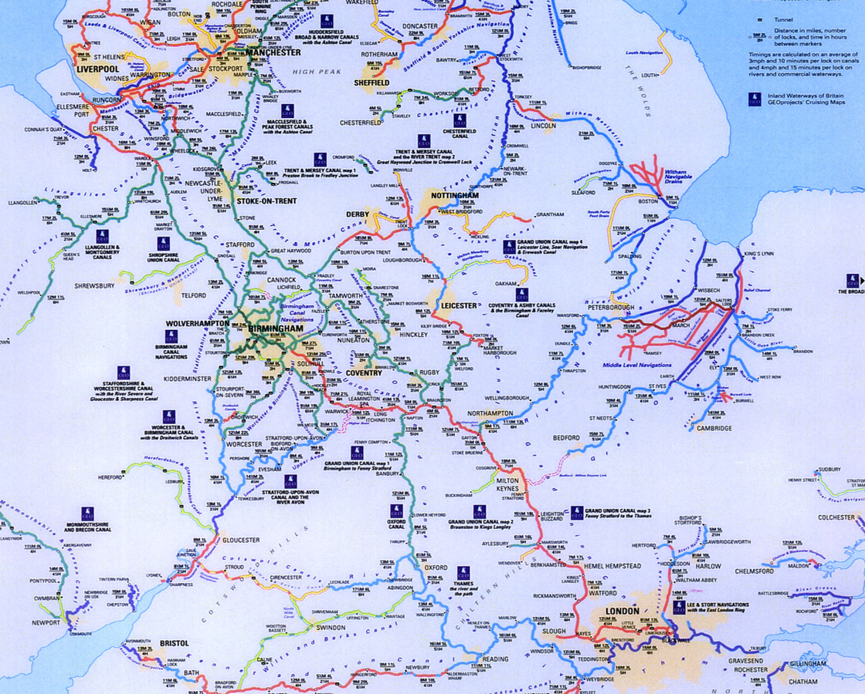

Trans-regional project

Slide 79
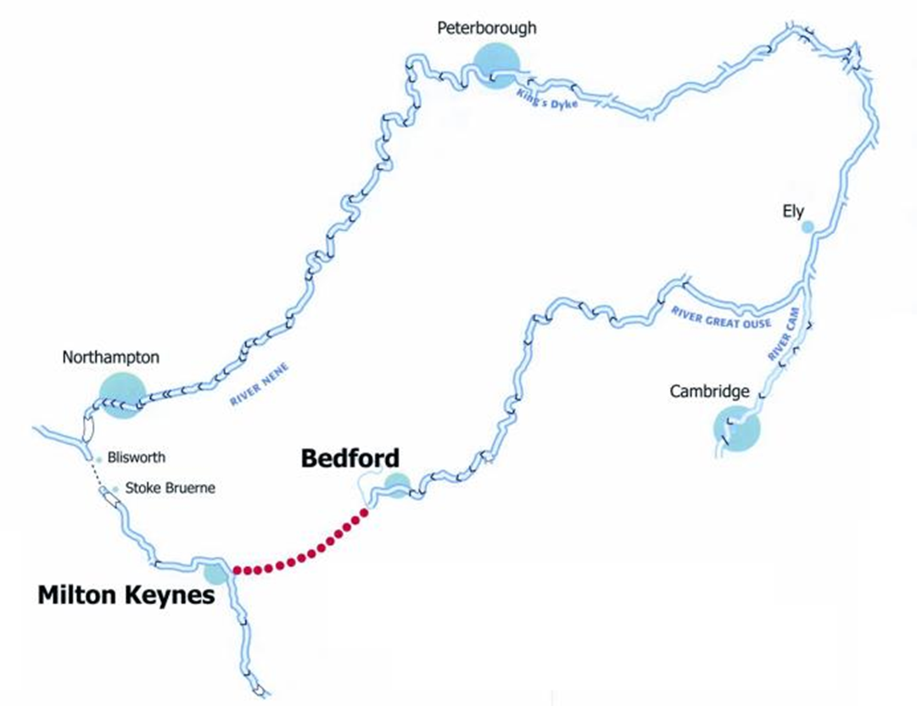

Closing the Gap

Slide 80
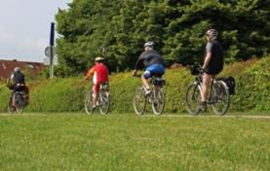



New Waterway Park
Catalyst for environmentally led regeneration
Generate new jobs in leisure & tourism
Promote healthier lifestyles
Increase biodiversity by linking major wetlands
Greatly improve water management in the region
  water storage
  flood and drainage
Build the first waterway for 100 years
Create a vital link in the Anglian regional waterway network
  Linking the Severn to Wash

Slide 81
Leisure Benefits
Development of over 26Km of new footpaths, bridleways
Opening up a wide range of recreational opportunities
Focus on Healthy lifestyles
  Walking, Rambling
  Cycling
  Horse riding
  Fishing
  Water based recreation and sports
Making new areas of countryside accessible to public
Increasing biodiversity through linking major wetlands
Introduction of new wetlands on the bank of canal

Slide 82

Create an iconic visitor centre
Access 50% of the UK population < 2 hrs drive
Develop a visitor centre and attraction similar to the Falkirk Wheel
Offer
  Range of land and water based activities

Slide 83
Economic benefits
Visitors to the Waterway Park: 85,000 day visitors / year
Boating & Boating Expenditure: 7,200 boat movements = £633k
Hire Boat Usage: +£599k
Visitor Expenditure: up to £4 million pa

Slide 84


National Infrastructure Commission
Cambridge/MK/Milton Keynes growth corridor
Call for evidence
Maximise potential of the corridor
High quality environment
Homes and Jobs
Priority Green Infrastructure

Slide 85


Slide 86
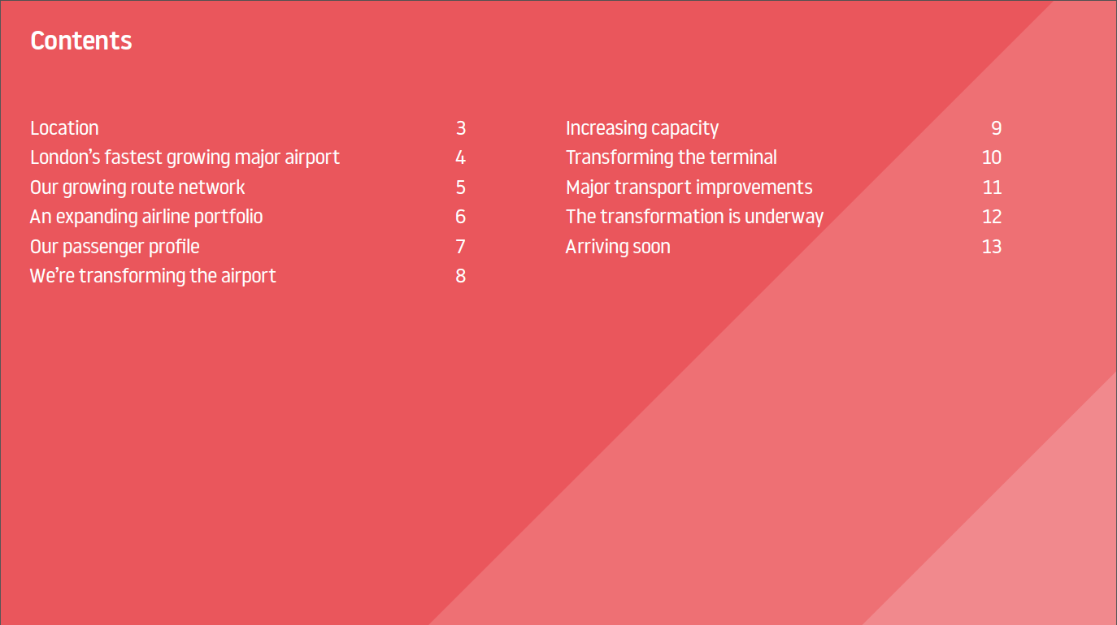

Slide 87
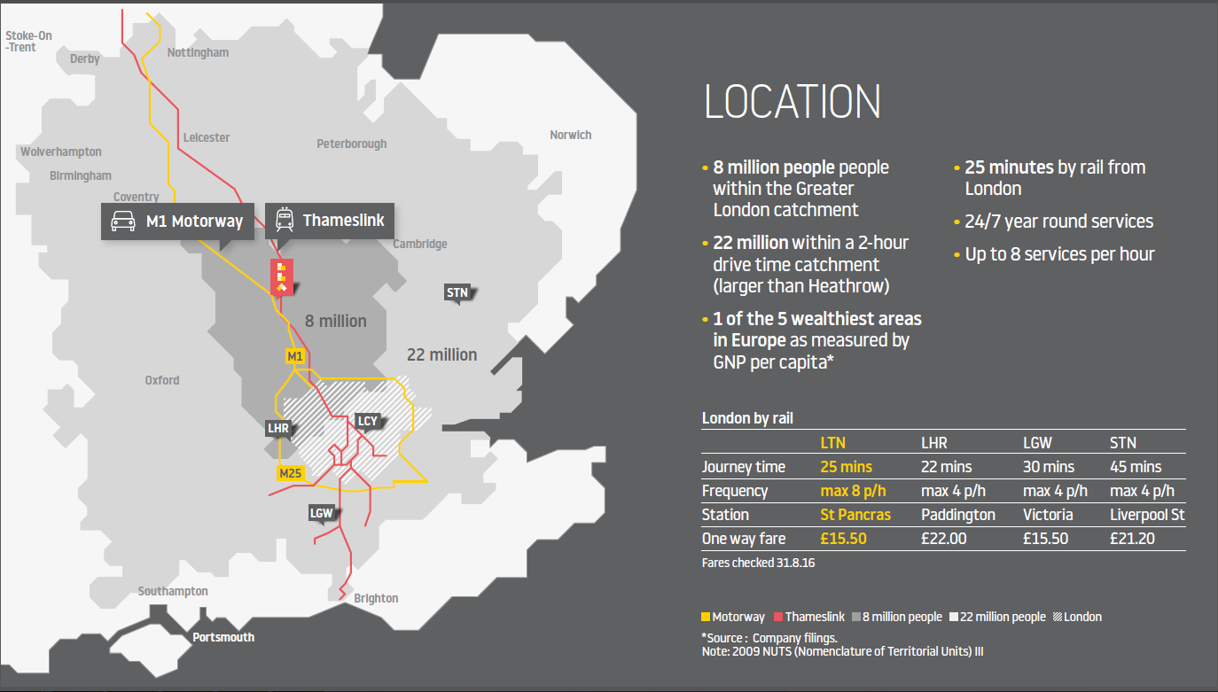

Slide 88
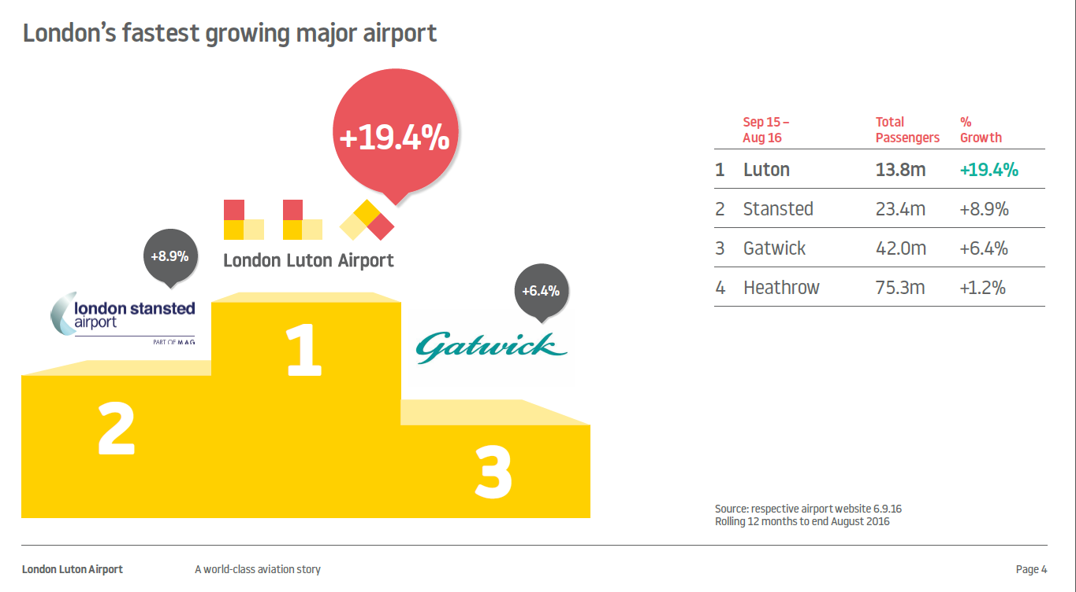

Slide 89
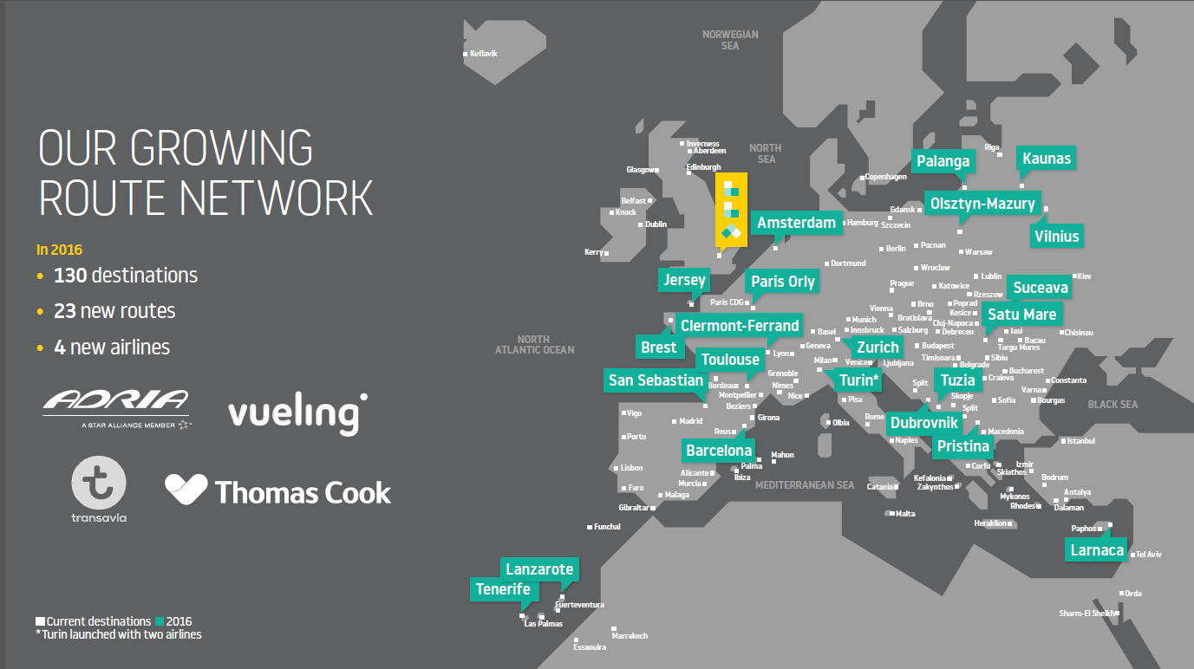

Slide 90
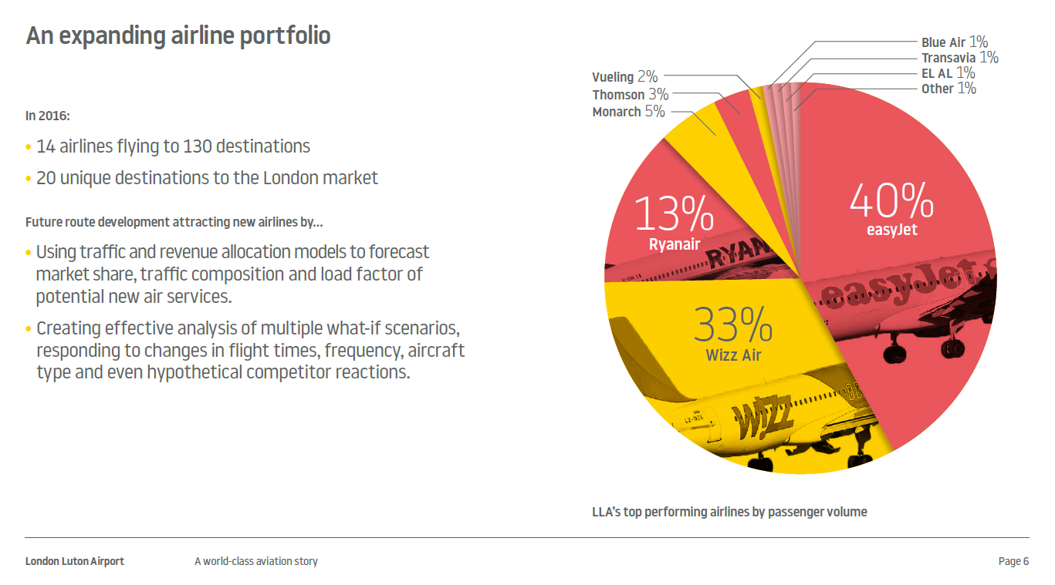

Slide 91
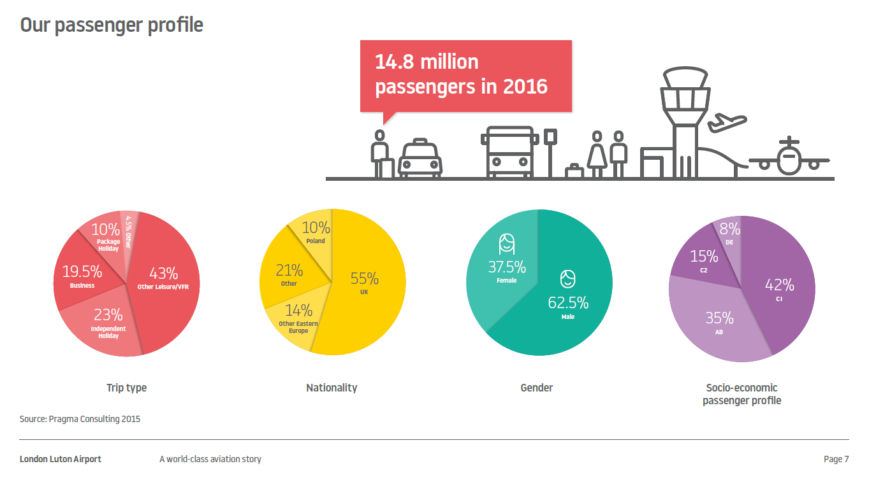

Slide 92
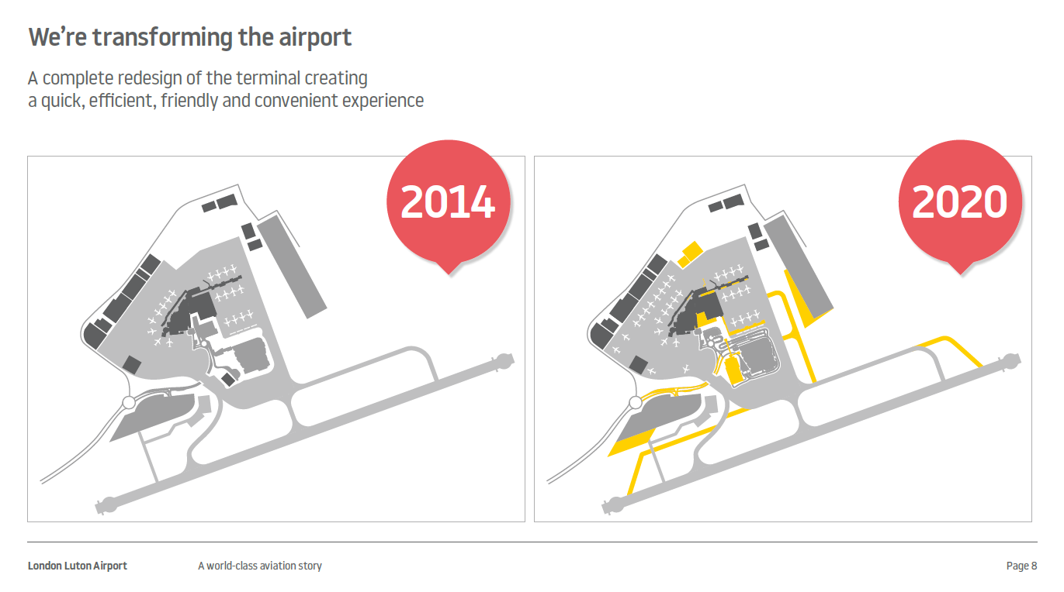

Slide 93
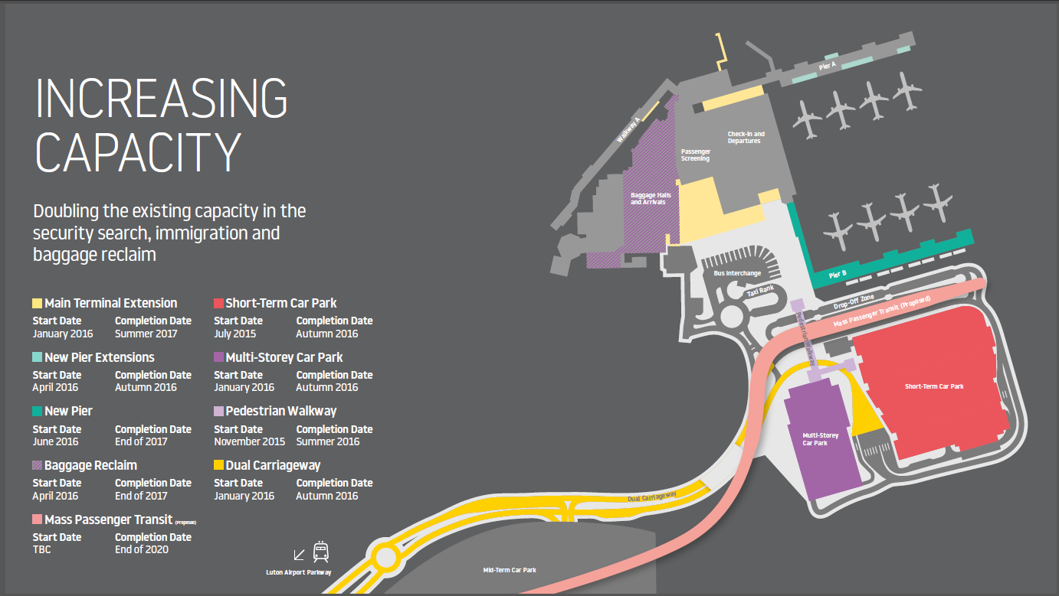

Slide 94


Slide 95
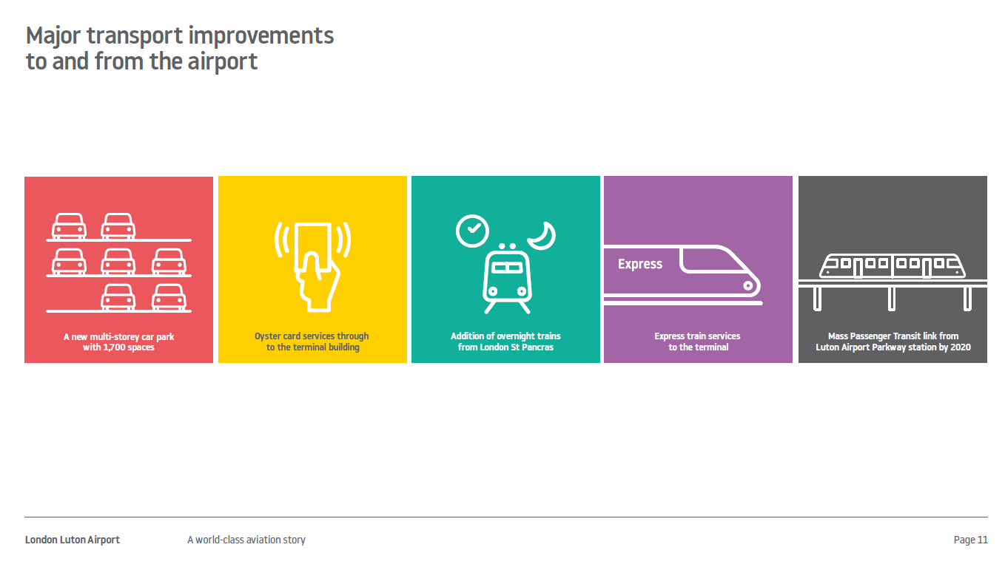

Slide 96
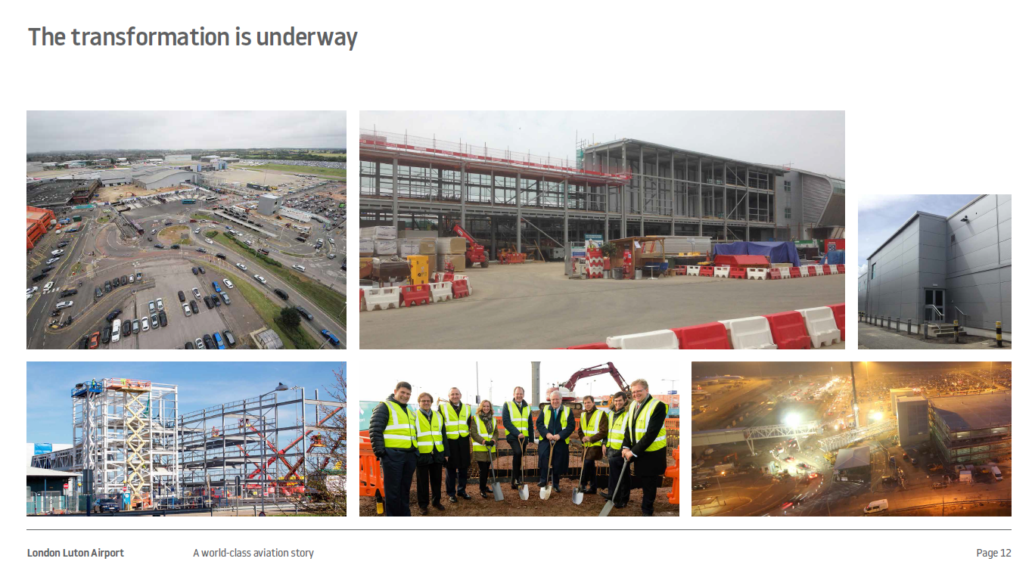

Slide 97


Slide 98
Phil Graham, Chief Executive
National Infrastructure Commission

Slide 99
Panel Discussion 1
Phil Hardy-Bishop, RICS
Phil Graham, NIC
Patrick O’Sullivan, EWR
Simon Amor, Highways England
Nick Barton, London Luton Airport
Jane Hamilton, B&MK Waterway Park

Slide 100
Panel Discussion 2
Paul Webster, IED
Hilary Chipping, SEMLEP
Ashley Stower, Network Rail
William Cuthbert, RBS
Clive Faine, Abbeygate Developments Ltd
Geoff Snelson, MK Council

Slide 101
Network Rail
Ashley Stower
Notes:
Introduce myself
…

Slide 102
What I will cover
What is Network Rail
Planning Infrastructure Renewals and Enhancements
Current Challenges
Moving Forward…

Slide 103
What is Network Rail
Responsible from 2002 for the stewardship of the national rail infrastructure network, now a public sector organisation
That is the track, tunnels, bridges , viaducts, stations, depots, structures , signalling, overhead lines, DC lines
Responsible for system safety, renewal and enhancement
It doesn’t operate passenger or freight train services
Employees over 30,000 people in all manner of roles and professions

Slide 104
Planning Rail Infrastructure
Funding is allocated in five year planning cycles called control periods, we are currently in CP5
Funding is made for renewal and enhancements works, safety is always the priority
Network Rail undertakes market studies (Long distance, London & the South East , Regional and Freight
Network Rail then identifies enhancements by Route studies which stakeholders are embedded into the process to understand what are the priority enhancement schemes
Application then to Dft for allocation of funding

Slide 105
Current Challenges
The rail network is the busiest for a 100 years, with year on year growth expected to rise continually for both passenger and freight.
Certain lines are at or reaching capacity
Major enhancements in CP5 were too ambitious given the amount of resources available in the market. Such as GWML electrification, NW Electrification and MML electrification
Lack of further enhancement funding from Dft
Skills in the market – example Signalling / Electrification engineers

Slide 106
Moving Forward
Examples of initiatives moving forward;
HS2 unlocks capacity on WCML
Property rationalisation – sale of rail property for housing to unlock funding
Attract third party funding
Network Rail Apprenticeship schemes
Maintenance now undertaken in house

Slide 107
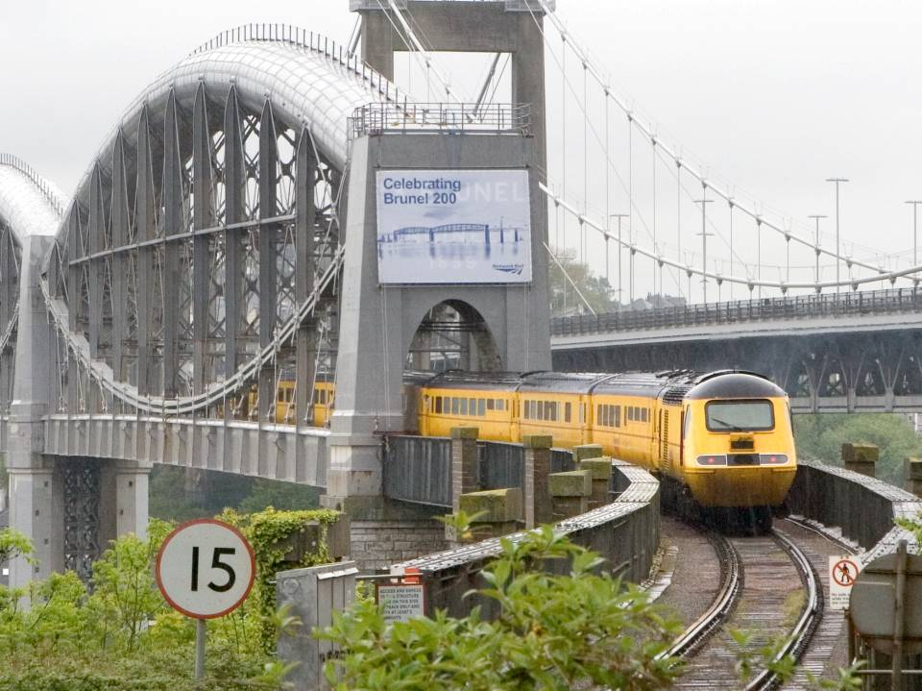
Notes:
This is what we’re known for – the New Measurement Train – keeping the spirit of IKB alive by developing innovative technology to let the railway prosper!

Slide 108
Panel Discussion 2
Paul Webster, IED
Hilary Chipping, SEMLEP
Ashley Stower, Network Rail
William Cuthbert, RBS
Clive Faine, Abbeygate Developments Ltd
Geoff Snelson, MK Council

Slide 109


MK Growth 2010-2026 – infrastructure challenges
28,000 new homes
1.5 jobs per home
Population grows to 300,000+
Reduce carbon emissions per head by 40% (by 2020)
Travel demand increase of 60%
but
practical capacity improvements address only 25% increase
MK Futures 2050 vision: further growth to 400,000 population

Slide 110













MK:SMART
Integrated innovation and support programme
City Data Hub
£16 million value
£8m Grant from HEFCE
£8 million industry match
Strategic Focus:
Energy
Water
Transport
Open Innovation
Enterprise hub
Education programme
Citizen innovation

Slide 111














City innovation ecosystem
Data hub and wireless networks support sensor deployments
Developer tools and innovation lab
Weather Sensors
Traffic
Counting
Street Lights
Pedestrian Counters
Bin Sensors
Air
Monitors
Bus
Car Park Sensors
Home Sensors
Satellite Images
Bus Feeds
Train Feeds

Slide 112












City Motion Map
City motion map
Data integration supports journey planning and mobility as a service
Santander cycles
Driverless saloon car trials
Driverless pods on demand
Induction charged electric bus service
Movement, parking
and timetable data
On demand, shared & low carbon mobility services

Slide 113
Panel Discussion 2
Paul Webster, IED
Hilary Chipping, SEMLEP
Ashley Stower, Network Rail
William Cuthbert, RBS
Clive Faine, Abbeygate Developments Ltd
Geoff Snelson, MK Council

Slide 114
Role of Local Enterprise Partnership - Conclusion and Next Steps
Stephen Catchpole, Chief Executive, SEMLEP

